Slide 1
Lecture on Disruptive Technologies [Autonomous Delivery Vehicles]
CE 4361 (Highway Engineering)
Subasish Das, Ph.D.

Slide 2
Outline
Research gap
Objective
Data collection
Analysis
Recommendations

Slide 3
Research Gap
The National Highway Traffic Safety Administration recently granted permission to deploy low-speed autonomous delivery vehicles (ADVs) on roadways.
Although the mobility of ADVs is limited to low-speed roads and these vehicles are occupantless, frequent stops and mobility among residential neighborhoods cause safety-related concerns.
There is consequently a need for a comprehensive safety impact analysis of ADVs. This study examined the safety implications and safety impacts of ADVs by using novel approaches.

Slide 4
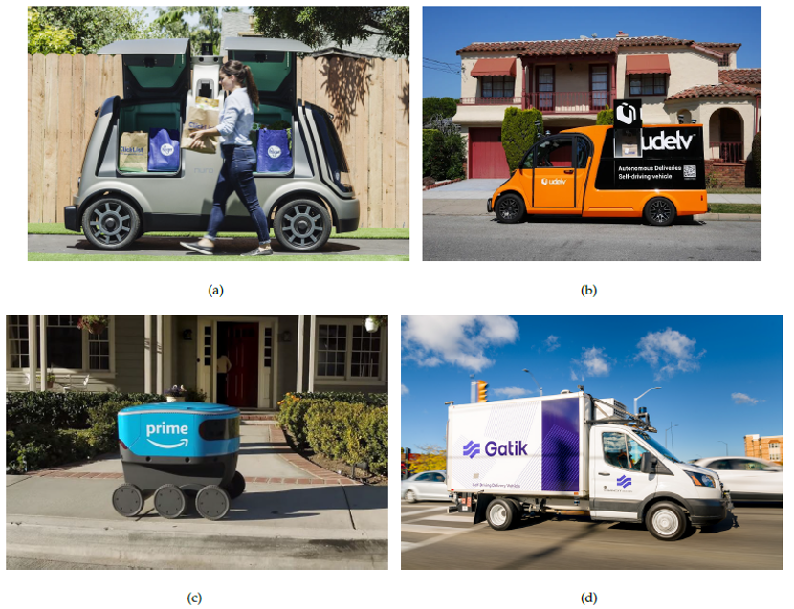
ADVs

Slide 5
Objectives
To explore the safety implication of ADVs
To determine critical association patterns of ADV involved traffic crashes
To develop a framework of ADV related safety analysis

Slide 6
Data Collection
Fatality Analysis Reporting System (FARS) [2016–2020]
Crash Report Sampling System (CRSS) [2016–2020]
California AV and ADV collision Data [2014–2020]
Waymo Open Data
Third-party ADV Trajectory Data (sample data)

Slide 7
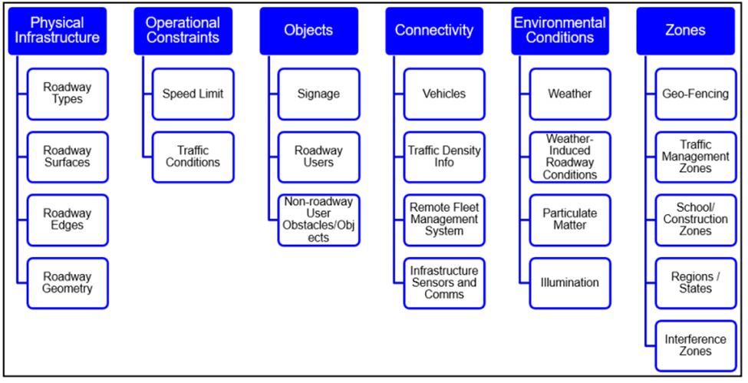
Operational Design Domain
Specific operating domains in which the CAV is designed to function.
May vary by original equipment maker (OEM).
Infrastructure Owner Operator (IOO):
Physical infrastructure (e.g., pavements, bridges).
TCDs and other roadside infrastructure.
Transportation systems management and operations (TSMO) and ITS infrastructure.
Urban multimodal infrastructure.
Source: Thorn, E., S. Kimmel, and M. Chaka, 2018. A Framework for Automated Driving System Testable Cases and Scenarios.
OEMs are responsible for defining their ODD and assume responsibility for safe operations within the ODD regardless of IOO actions.

Slide 8
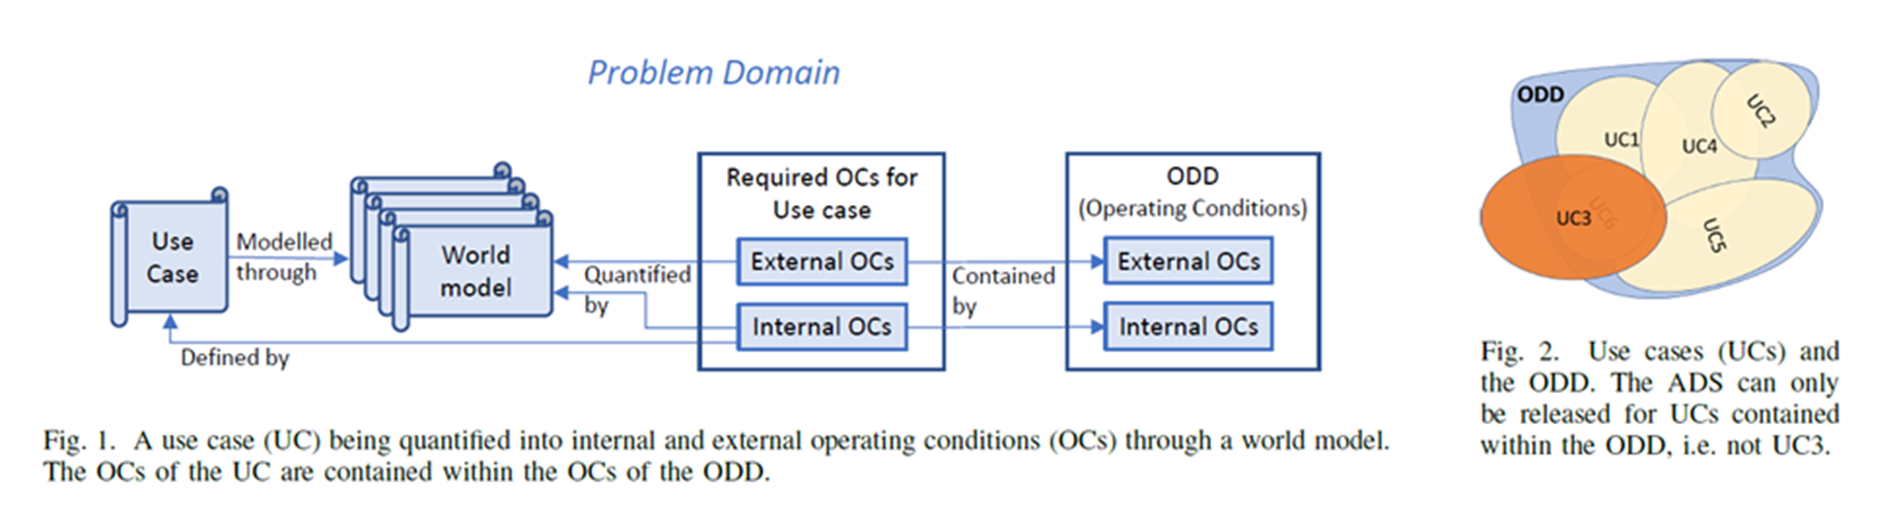
Use Cases

Slide 9
Safety Implication Analysis
Functional Class | FARS | CRSS
ADV ODD Definition | Light vehicles and posted speed limit (less than 50 mph) and non-interstate roadways and vehicle models not older than 2000 | Light vehicles and posted speed limit (less than 50 mph) and non-interstate roadways and vehicle models not older than 2000 and non-fatal and non-property damage only
All Crashes (2016­–2020) | 172,237 | 259,077
ADV ODD Defined Crashes (2016–2020) | 37,692 | 55,221
All Vehicles Involved in Crashes (2016–2020) | 263,647 | 457,314
ADV ODD Defined Vehicles Involved in Crashes (2016-2020) | 43,683 | 73,440

Slide 10
Occupants based on ADV Scenarios in FARS
Number of Occupants | 2016 | 2017 | 2018 | 2019 | 2020 | Total
0 | 15 | 17 | 18 | 15 | 14 | 79
1 | 5,384 | 5,530 | 5,817 | 5,537 | 6,066 | 28,334
2 | 1,864 | 1,942 | 1,880 | 1,855 | 1,976 | 9,517
3 or more | 1,005 | 1,236 | 1,139 | 1,147 | 1,226 | 2,923
Total | 8,268 | 8,725 | 8,854 | 8,554 | 9,282 | 43,683

Slide 11
Association Rule Mining (ARM) Example
For Intersection Related Crashes, one rule is:
Collision= Head-on, Intersection= No -> Alignment= Curve
Crashes under Dark No Streetlight: 4,852
Crashes under Alcohol=Yes: 1087
Crashes under both dark no streetlight and Alcohol=Yes : 441
Total Intersection related crashes= 32,940
Support= 441/32940=1%
Confidence= 441/1087= 40.57%
Lift= (441/1087)/(4852/32940)= 2.75
Collision= Head-on, Intersection= No
Alignment= Curve

Slide 12
Study Design
Safety Implication Analysis
Fatality Analysis Reporting System (FARS) [2016–2020]
Safety Impact Analysis
California AV and ADV collision Data [2014–2020]
Waymo Open Data
Third-party ADV Trajectory Data (sample data)

Slide 13
Safety Implication Analysis
Rules | Antecedent | Consequent | Supp. | Conf. | Lift | Count
R#01 | Coll = Front-to-Front, Int = Not an Intersection | Align = Curve | 0.054 | 0.312 | 2.868 | 1248
R#02 | Int = Four-Way Intersection, TrWay = Two-Way Divided, PSL = 45 MPH, Align = Straight | TCD = Traffic control signal | 0.054 | 0.819 | 2.689 | 1266
R#03 | Int = Four-Way Intersection, TrWay = Two-Way Divided, Align = Straight | TCD = Traffic control signal | 0.109 | 0.798 | 2.619 | 2531
R#04 | Int = Four-Way Intersection, TrWay = Two-Way Divided | TCD = Traffic control signal | 0.114 | 0.797 | 2.614 | 2644
R#05 | Coll = Angle, Int = Four-Way Intersection, TrWay = Two-Way Divided, Align = Straight | TCD = Traffic control signal | 0.079 | 0.78 | 2.56 | 1837
R#06 | Coll = Angle, Int = Four-Way Intersection, TrWay = Two-Way Divided | TCD = Traffic control signal | 0.083 | 0.777 | 2.55 | 1920
R#07 | Coll = Front-to-Front, TCD = No Controls | Align = Curve | 0.052 | 0.276 | 2.542 | 1204
R#08 | Coll = Angle, Int = Four-Way Intersection, TrWay = Two-Way Undivided, Align = Straight | TCD = Stop Sign | 0.061 | 0.307 | 2.528 | 1408
R#09 | Coll = Front-to-Front, TrWay = Two-Way Undivided | Align = Curve | 0.052 | 0.273 | 2.516 | 1202
R#10 | Coll = Angle, Int = Four-Way Intersection, TrWay = Two-Way Undivided | TCD = Stop Sign | 0.063 | 0.302 | 2.492 | 1461

Slide 14
Safety Impact Analysis (CA AV Collision Data)
Rules | Antecedent | Consequent | Supp. | Conf. | Lift | Count
R#01 | AV = Proceeding Straight | OtherVeh = Changing Lanes | 0.057 | 0.207 | 2.499 | 18
R#02 | Pre_Crash_Mode = Conventional, AV = Stopped, Weather = Clear, Collision_Type = Rear End | OtherVeh = Proceeding Straight | 0.051 | 0.842 | 1.862 | 16
R#03 | Pre_Crash_Mode = Autonomous, AV = Stopped, OtherVeh = Proceeding Straight, Weather = Clear, Lighting = Daylight | Collision_Type = Rear End | 0.086 | 0.931 | 1.839 | 27
R#04 | Pre_Crash_Mode = Conventional, AV = Proceeding Straight, Weather = Clear | Collision_Type = Side Swipe | 0.051 | 0.390 | 1.829 | 16
R#05 | Pre_Crash_Mode = Conventional, AV = Stopped, Collision_Type = Rear End | OtherVeh = Proceeding Straight | 0.061 | 0.826 | 1.827 | 19
R#06 | Pre_Crash_Mode = Autonomous, AV = Stopped, OtherVeh = Proceeding Straight, Lighting = Daylight | Collision_Type = Rear End | 0.096 | 0.909 | 1.795 | 30
R#07 | Pre_Crash_Mode = Autonomous, OtherVeh = Proceeding Straight, Weather = Clear, Lighting = Daylight | Collision_Type = Rear End | 0.124 | 0.907 | 1.791 | 39
R#08 | Pre_Crash_Mode = Autonomous, OtherVeh = Proceeding Straight, Lighting = Daylight | Collision_Type = Rear End | 0.137 | 0.896 | 1.769 | 43
R#09 | Pre_Crash_Mode = Conventional, AV = Stopped, Lighting = Daylight, Collision_Type = Rear End | OtherVeh = Proceeding Straight | 0.051 | 0.800 | 1.769 | 16
R#10 | Pre_Crash_Mode = Autonomous, Lighting = Daylight, Collision_Type = Rear End | AV = Stopped | 0.162 | 0.699 | 1.741 | 51

Slide 15
Jerk Analysis using Waymo Open Data
Waymo ADV-related trajectories.
The absolute jerk values larger than 15 were considered as not physically feasible. Also, more than one sign inversion in a one-second window was defined as an anomalous jerk sign inversion.
By limiting the data to the ADV ODD scenario (light vehicles and posted speed limit less than 50 mph and non-interstate roadways), the anomaly jerk proportion was determined to be 3.7% with a maximum jerk of 50 m/s3 and minimum jerk of -50 m/s3.
The jerk analysis outcome shows that the dataset itself is not consistent by showing significant anomalies. It’s mostly due to the operation of ADVs in low-speed roadways.

Slide 16
Safety Critical Events from ADV Sample Dataset
The ADV sample dataset contains trajectory level information for three major events (hard braking, over speeding, and excessive over speeding).
Unique trips= 99.
Generated 25 rules from the unsupervised data.
These safety-critical events represent 43% of all trajectory points and 6% of total trips.

Slide 17
Key Rules
Rules | Count | Hard Braking Mean | Hard braking Rank | Over-speeding Rank | Excessive Over-speeding Mean | Excessive Over-speeding Rank | Average Rank
T#01 | 574 | 0.0592 | 18 | 13 | 0.4495 | 13 | 17.67
T#02 | 929 | 0.0517 | 19 | 17 | 0.5802 | 17 | 18.00
T#03 | 2977 | 0.0390 | 22 | 22 | 0.6537 | 22 | 19.67
T#04 | 2140 | 0.0318 | 25 | 16 | 0.5575 | 16 | 20.00
T#05 | 7721 | 0.0284 | 27 | 18 | 0.6193 | 18 | 20.33
T#06 | 777 | 0.0257 | 29 | 14 | 0.5084 | 14 | 21.00
T#07 | 1915 | 0.0862 | 13 | 19 | 0.1102 | 19 | 21.67
T#08 | 2953 | 0.0474 | 21 | 45 | 0.8300 | 45 | 23.33
T#09 | 3692 | 0.0181 | 30 | 35 | 0.8226 | 35 | 23.67
T#10 | 2171 | 0.0170 | 33 | 12 | 0.1612 | 12 | 25.67
T#11 | 607 | 0.2010 | 9 | 23 | 0.0148 | 23 | 26.33
T#12 | 1074 | 0.0102 | 40 | 42 | 0.9097 | 42 | 27.67
T#13 | 1667 | 0.0078 | 48 | 8 | 0.2346 | 8 | 28.00
T#14 | 979 | 0.0061 | 57 | 10 | 0.2993 | 10 | 30.67
T#15 | 5866 | 0.0085 | 46 | 21 | 0.2659 | 21 | 31.00
T#16 | 646 | 0.0062 | 56 | 32 | 0.8173 | 32 | 31.67
T#17 | 8206 | 0.2516 | 6 | 38 | 0.0090 | 38 | 31.67
T#18 | 19895 | 0.0034 | 67 | 20 | 0.6544 | 20 | 33.67
T#19 | 6377 | 0.0804 | 15 | 47 | 0.0612 | 47 | 34.00
T#20 | 579 | 0.9655 | 2 | 55 | 0.0173 | 55 | 34.33

Slide 18

USDOT Safe System (SS)

Slide 19
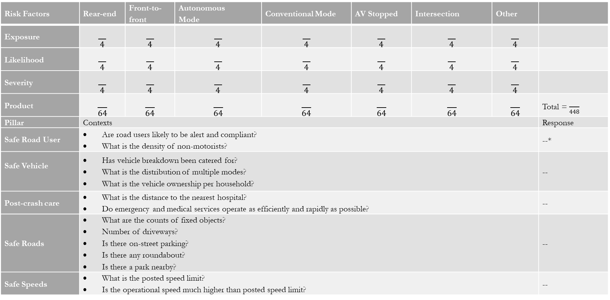
SS based ADV related Decision Support Matrix
Risk Factors | Rear-end | Front-to-front | Autonomous Mode | Conventional Mode | AV Stopped | Intersection | Other
Exposure | $$\frac{}{4}$$ | $$\frac{}{4}$$ | $$\frac{}{4}$$ | $$\frac{}{4}$$ | $$\frac{}{4}$$ | $$\frac{}{4}$$ | $$\frac{}{4}$$
Likelihood | $$\frac{}{4}$$ | $$\frac{}{4}$$ | $$\frac{}{4}$$ | $$\frac{}{4}$$ | $$\frac{}{4}$$ | $$\frac{}{4}$$ | $$\frac{}{4}$$
Severity | $$\frac{}{4}$$ | $$\frac{}{4}$$ | $$\frac{}{4}$$ | $$\frac{}{4}$$ | $$\frac{}{4}$$ | $$\frac{}{4}$$ | $$\frac{}{4}$$
Product | $$\frac{}{64}$$ | $$\frac{}{64}$$ | $$\frac{}{64}$$ | $$\frac{}{64}$$ | $$\frac{}{64}$$ | $$\frac{}{64}$$ | $$\frac{}{64}$$ | Total = $\frac{}{448}$
Pillar | Contexts |  |  |  |  |  |  | Response
Safe Road User | Are road users likely to be alert and compliant? What is the density of non-motorists? |  |  |  |  |  |  | --*
Safe Vehicle | Has vehicle breakdown been catered for? What is the distribution of multiple modes? What is the vehicle ownership per household? |  |  |  |  |  |  | --
Post-crash care | What is the distance to the nearest hospital? Do emergency and medical services operate as efficiently and rapidly as possible? |  |  |  |  |  |  | --
Safe Roads | What are the counts of fixed objects? Number of driveways? Is there on-street parking? Is there any roundabout? Is there a park nearby? |  |  |  |  |  |  | --
Safe Speeds | What is the posted speed limit? Is the operational speed much higher than posted speed limit? |  |  |  |  |  |  | --

Slide 20
Scoring Criteria
Road User Exposure | Crash likelihood | Crash severity
0 = there is no exposure to a certain crash type. | 0 = there is only minimal chance that a given crash type can occur. | 0 = should a crash occur, there is only minimal chance that it will result in a fatality or serious injury to the relevant road user involved.
1 = volumes of vehicles that may be involved in a particular crash type are particularly low, and therefore exposure is low. AADT is < 400 vehicles per day (vpd). | 1 = it is highly unlikely that a given crash type will occur. | 1 = should a crash occur; it is highly unlikely that it will result in a fatality or serious injury to any road user involved. Kinetic energies must be fairly low during a crash.
2 = volumes of vehicles that may be involved in a particular crash type are moderate, and therefore exposure is moderate. AADT is between 400 and 1,000 vpd. | 2 = it is unlikely that a given crash type will occur. | 2 = should a crash occur; it is unlikely that it will result in a fatality or serious injury to any road user involved. Kinetic energies are moderate.
3 = volumes of vehicles that may be involved in a particular crash type are high, and therefore exposure is high. AADT is between 1,000 and 2,000 vpd. | 3 = it is likely that a given crash type will occur. | 3 = should a crash occur; it is likely that it will result in a fatality or serious injury to any road user involved. Kinetic energies are moderate but are not effectively dissipated.
4 = volumes of vehicles that may be involved in a particular crash type are very high, or the road is very long, and therefore exposure is very high. AADT is > 2,000 vpd. | 4 = the likelihood of individual road user errors leading to a crash is high given the infrastructure in place. | 4 = should a crash occur; it is highly likely that it will result in a fatality or serious injury to any road user involved. Kinetic energies are high enough to cause a fatal and serious injury crash.

Slide 21
Key Findings
Innovative technologies such as ADVs can offer benefits that transcend the typical approaches used in vehicle safety, including passive and active safety measures.
The safety implication scores (around 27% reduction due to the reduction of single vehicle occupantless collisions) is hard to attain in the real-world deployment of ADVs.

Slide 22
Key Findings
The trajectory analysis provides evidence minimal anomalies, which is due to the operation on low-speed roadways.
Given the high frequency of non-motorist-related traffic crashes every year, it is important to examine the crash compatibility with vulnerable roadway users.
As ADV trips are more frequent in roadway networks with higher driveway densities and non-motorist trips, it is important to investigate large-scale ADV trajectory data from prominent ADV companies such as Nuro.

Slide 23
Questions?

